Slide 1
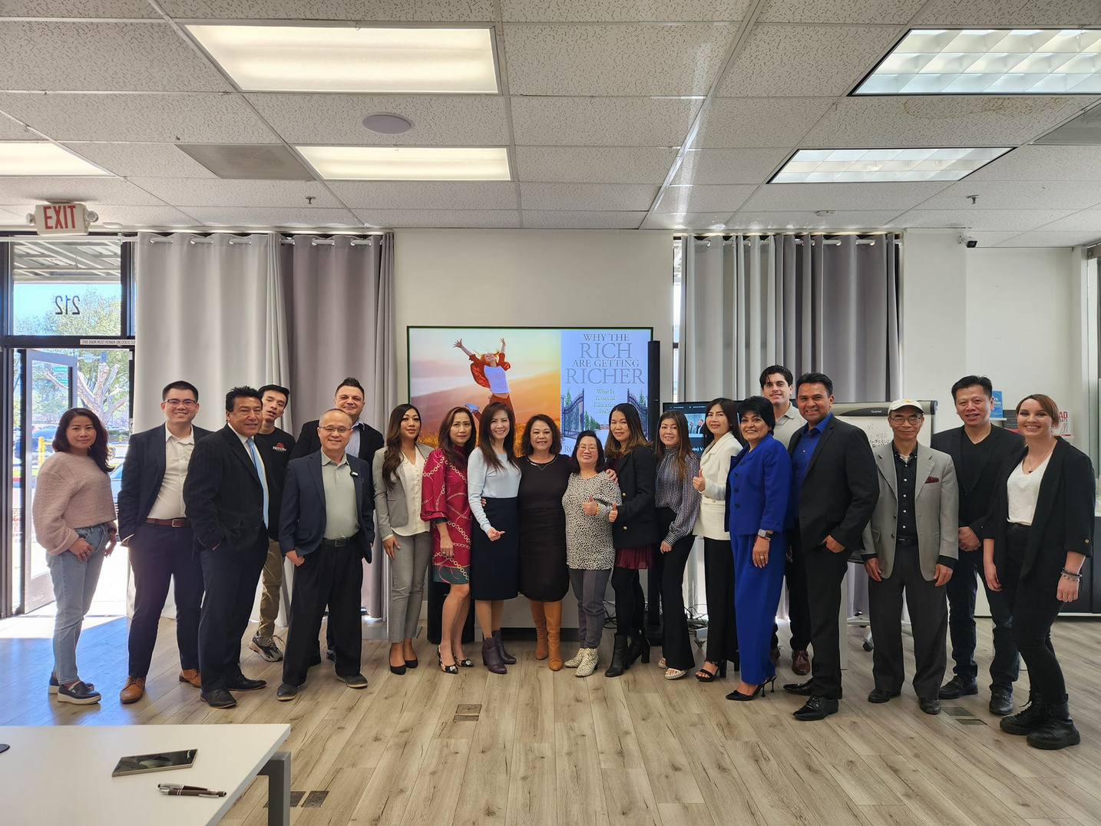


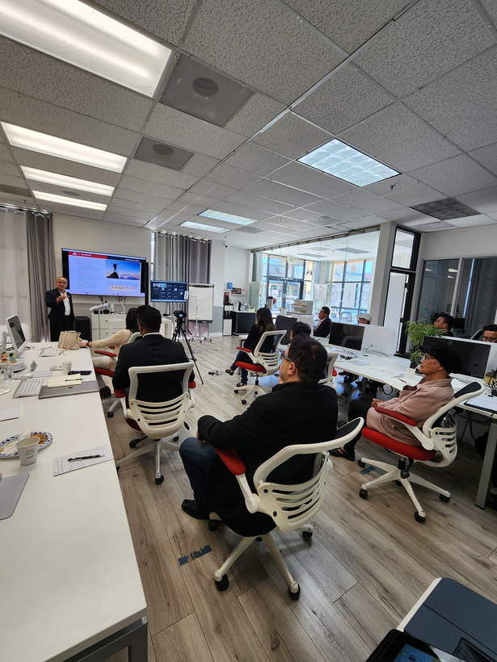
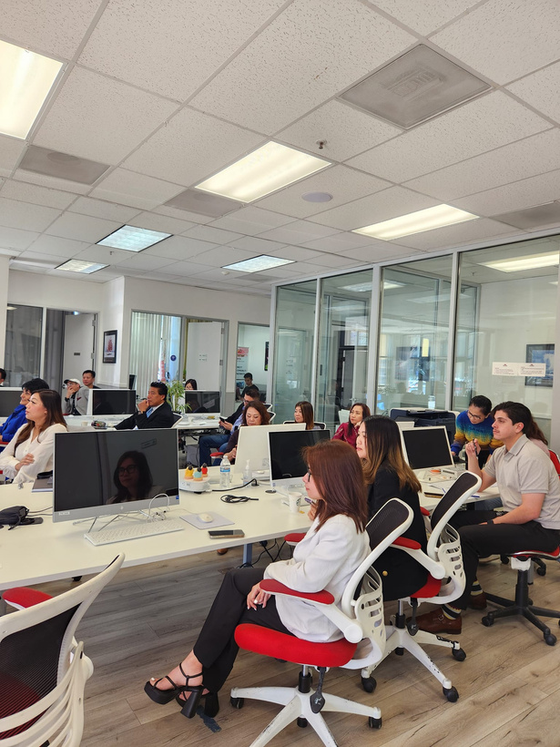




20% DOWN PAYMENT ASSISTANCE
DREAM FOR ALL
Who is this event for?
  1st time homebuyers who need down payment
Location
  0% interest rate for 30 year
Pacificwide Real Estate & Mortgage
3005 Silver Creek Road Ste 215
How to register for this event?
Date and Time
Text
Saturday , Mar 23, 2024
408-393-2068
10AM

