Slide 1



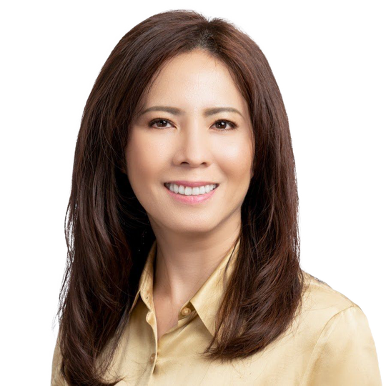



Attention Business Owners!
To download, Go to file>Export>Change File Type>Choose Either PNG OR JPG and choose the slide you want to convert to image.
Or you can click shift+F5 and screenshot for better quality
12 OR 24 MONTH BANK STATEMENT
To Remove any background on your picture you can email ivan.hustleph@gmail.com or go to this website: https://www.remove.bg/
Loan amount $300,000 - $10,000,000
Reserves:
30YR Fixed, 5YR IO + 25 YR Fixed
  0 months for 75% LTV and lower
  6 months 75.1% LTV and greater
  12 Months 85% LTV and greater
FICO Minimums
  600 with personal statements
  600 with business statements
LTV Max:
  90% LTV purchase
  80% LTV refi
MINH CHAU NGUYEN
Loan Manager
NMLS No. 348726 - CalBRE No. 01392364
mchau@pacificwide.com
408-393-2068

Slide 2


Attention RE Investors!
To download, Go to file>Export>Change File Type>Choose Either PNG OR JPG and choose the slide you want to convert to image.
Or you can click shift+F5 and screenshot for better quality
To Remove any background on your picture you can email ivan.hustleph@gmail.com or go to this website: https://www.remove.bg/
DSCR
Loan Amount $300,000 - $3,000,000
5YR or 3YR prepay penalty (can be bought out/down)
5/1 ARM, 7/1 ARM, 30YR Fixed, 5YR IO (30YR term)
Lender Paid Comp up to 3 points! Can combine points borrower paid with lender paid as well
575 min FICO
80% LTV Purchase and 75% REFI
No income/employment verification
Lease agreements of subject property used to qualify ( Fair market rents / 1007 Rental Survey )
  Subject rent PITIA reduced to 1.0 : 1.0 Able to cash flow negatively down to .80 with adds to the rate
MINH CHAU NGUYEN
Loan Manager
NMLS No. 348726 - CalBRE No. 01392364
mchau@pacificwide.com
408-393-2068

Slide 3

KHÔNG CẦN LÀ NGƯỜI MỸ VẪN MƯỢN NỢ MUA NHÀ Ở MỸ ĐƯỢC!
To download, Go to file>Export>Change File Type>Choose Either PNG OR JPG and choose the slide you want to convert to image.
Or you can click shift+F5 and screenshot for better quality
FOREIGN
To Remove any background on your picture you can email ivan.hustleph@gmail.com or go to this website: https://www.remove.bg/
NATIONALS
Dễ & Nhanh!
(INVESTMENT ONLY)
Loan amount $300,000 - $3,000,000
30YR Fixed, 5YR IO + 25 YR Fixed
Chỉ cần 25% tiền down payment của người mua, còn lại mượn của ngân hàng!
LTV Max:
  75% LTV purchase (25% down payment)
No Reserves
Nhanh nhất là gọi 408-393-2068
MINH CHAU NGUYEN
Loan Manager
NMLS No. 348726 - CalBRE No. 01392364
mchau@pacificwide.com
408-393-2068

Slide 4

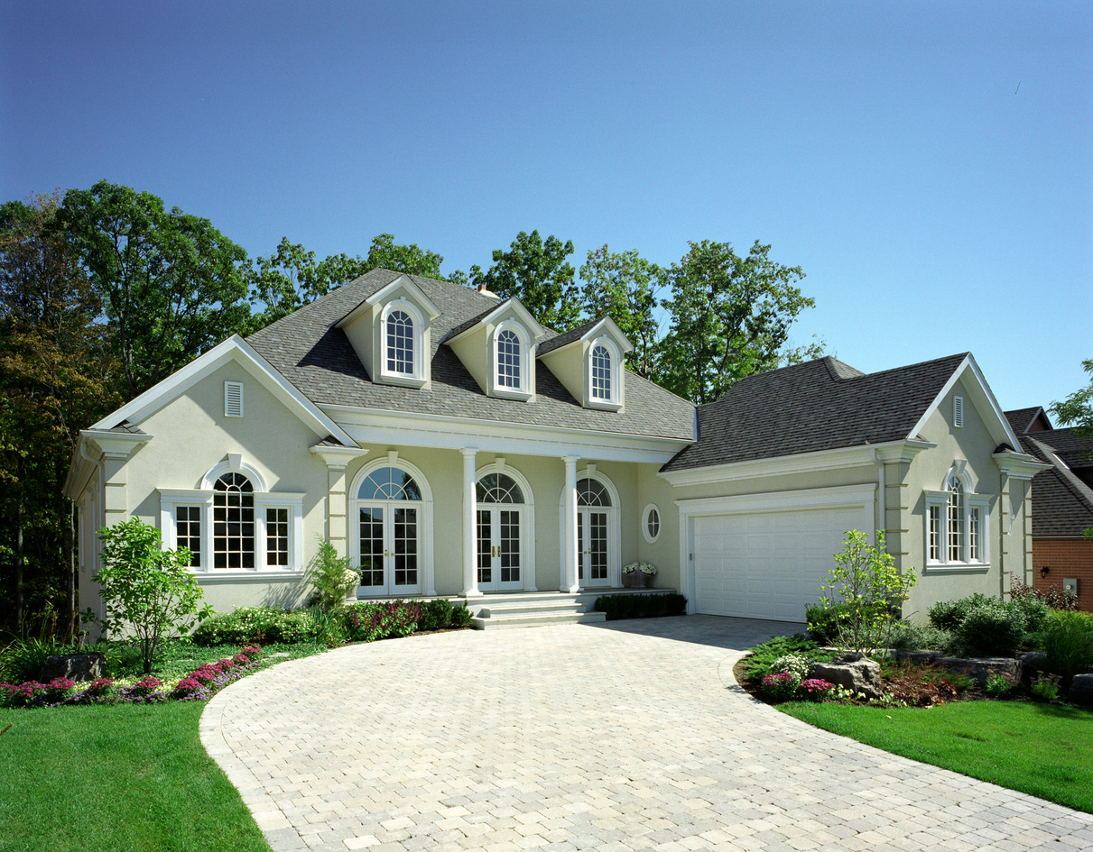
ATTENTION: NO SEGURO SOCIAL? NO PROBLEMA!
To download, Go to file>Export>Change File Type>Choose Either PNG OR JPG and choose the slide you want to convert to image.
Or you can click shift+F5 and screenshot for better quality
To Remove any background on your picture you can email ivan.hustleph@gmail.com or go to this website: https://www.remove.bg/
ITIN
(PRIMARY/INVESTMENT)
Loan amount $300,000 - $1,000,000
LTV Max:
  80% LTV Purchase (20% Down Payment)
  75% LTV Refinance
Eligible programs:
  Full Doc for primary
  12MO Bank Statement for primary or Investment
  No Reserves Required
MINH CHAU NGUYEN
Loan Manager
NMLS No. 348726 - CalBRE No. 01392364
mchau@pacificwide.com
408-393-2068

Slide 5




MINH CHAU NGUYEN
Loan Manager
NMLS No. 348726 - CalBRE No. 01392364
To download, Go to file>Export>Change File Type>Choose Either PNG OR JPG and choose the slide you want to convert to image.
Or you can click shift+F5 and screenshot for better quality
mchau@pacificwide.com
408-393-2068
MULTI FAMILY
5- 24 UNIT COMPLEXES
Loan amount $500,000 - $3,000,000
To Remove any background on your picture you can email ivan.hustleph@gmail.com or go to this website: https://www.remove.bg/
70% Max LTV
675 Minimum Fico Score
Minimum 1.00 DSCR ratio
Entities only
Terms 30 year Fixed & 5 year I/O & 25 years fully amortized

Slide 6

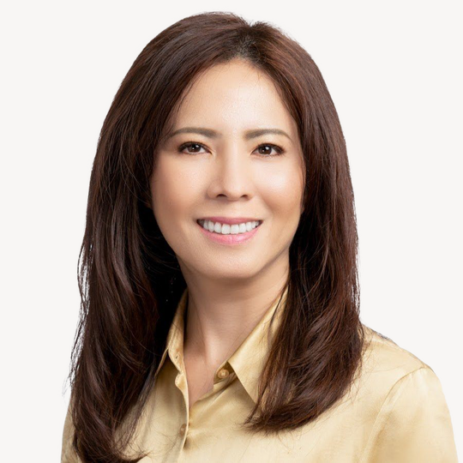

To download, Go to file>Export>Change File Type>Choose Either PNG OR JPG and choose the slide you want to convert to image.
Or you can click shift+F5 and screenshot for better quality
To Remove any background on your picture you can email ivan.hustleph@gmail.com or go to this website: https://www.remove.bg/
WVOE ONLY
MINH CHAU NGUYEN
Loan Manager
NMLS No. 348726 - CalBRE No. 01392364
Written Verification of Employment Only
mchau@pacificwide.com
408-393-2068
20% Down Payment
Min 600 FICO
Property Types: SFR/Condo/Townhome
Borrower cannot be employed by a family member

Slide 7


MINH CHAU NGUYEN
Loan Manager
NMLS No. 348726 - CalBRE No. 01392364
To download, Go to file>Export>Change File Type>Choose Either PNG OR JPG and choose the slide you want to convert to image.
Or you can click shift+F5 and screenshot for better quality
mchau@pacificwide.com
408-393-2068
1099 ONLY
Most recent two years 1099s
No 1st Time Homebuyer
To Remove any background on your picture you can email ivan.hustleph@gmail.com or go to this website: https://www.remove.bg/
Latest 2 months bank statements
Property Types: SFR/Condo/Townhome
Min 20% Down Payment
Min 600 FICO

Slide 8
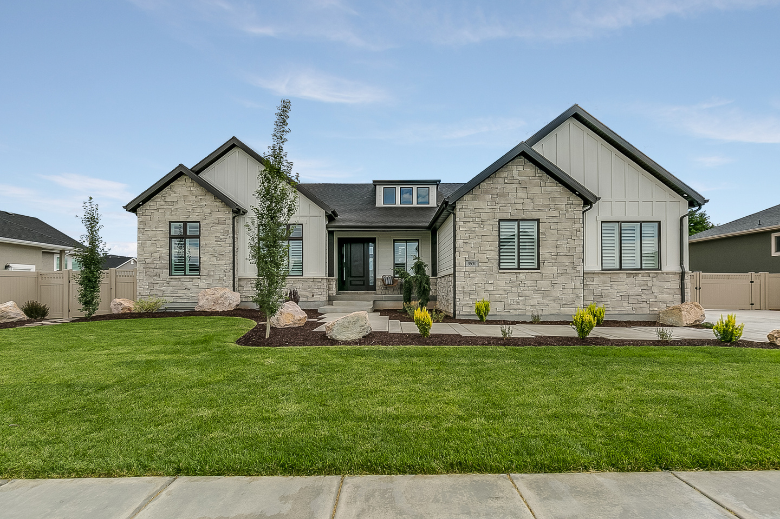

Attention Business Owners!
To download, Go to file>Export>Change File Type>Choose Either PNG OR JPG and choose the slide you want to convert to image.
Or you can click shift+F5 and screenshot for better quality
To Remove any background on your picture you can email ivan.hustleph@gmail.com or go to this website: https://www.remove.bg/
P&L
CPA prepared P&L on CPA’s letterhead
Min 20% Down Payment
Min 600 FICO
Property Types: SFR/Condo/Townhome
MINH CHAU NGUYEN
Loan Manager
NMLS No. 348726 - CalBRE No. 01392364
mchau@pacificwide.com
408-393-2068

