Slide 1

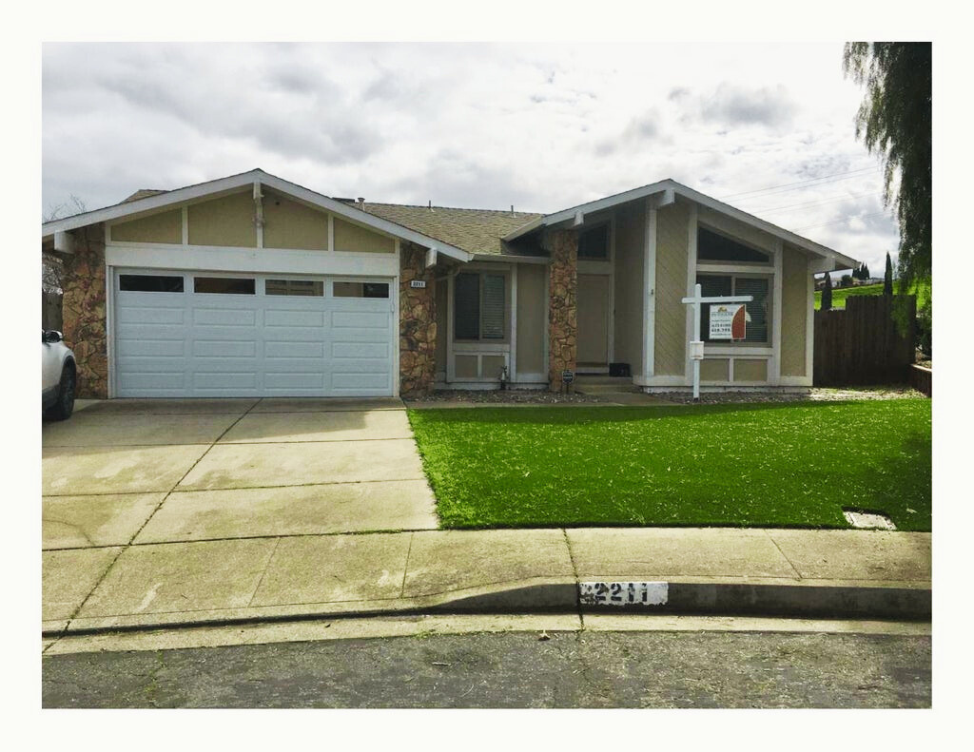









OPEN HOUSE
2211 Zennia Ct, PITTSBURG, CA
To download, Go to file>Export>Change File Type>Choose Either PNG OR JPG and choose the slide you want to convert to image.
Or you can click shift+F5 and screenshot for better quality
OFFER
$624,950
1,610 sqft
3 Bedrooms
2 Bathrooms
Welcome to 2211 Zennia Ct.! This stunning home in Pittsburg, CA, offers 3 bedrooms, including a master suite, 2 bathrooms, and elegant features like vaulted ceilings and wood floors. Enjoy entertaining in the gourmet kitchen and separate family room with a cozy fireplace. Outside, the large deck and spacious backyard are perfect for outdoor activities. Don't miss out on this beautiful property in the desirable Pittsburg Unified School District
To Remove any background on your picture you can email ivan.hustleph@gmail.com or go to this website: https://www.remove.bg/
YOUR FINANCING OPTIONS
 | Conventional | Conventional | FHA | FHA
Loan Amount | $ 562,500.00 | $ 500,000.00 | $ 603,125.00 | $ 562,500.00
Down Payment % | 10% | 20% | 3.50% | 10%
Down Payment $ | $ 62,500.00 | $ 125,000.00 | $ 21,875.00 | $ 62,500.00
Loan Terms | 30 Years Fixed | 30 Years Fixed | 30 Years Fixed | 30 Years Fixed
Interest Rates | 7.50% | 7.50% | 6.63% | 6.63%
Discount Points | 0% | 0% | 0% | 0%
Underwriting Fee | $ 1,295.00 | $ 1,295.00 | $ 1,295.00 | $ 1,295.00
Upfront MI (1.75%) | 0% | 0% | $ 10,554.69 | $ 9,843.75
Monthly MI | $ 99.00 | $ - | $ 276.00 | $ 234.00
Property Tax | $ 652.00 | $ 652.00 | $ 652.00 | $ 652.00
Homeowner's Insurance | $ 100.00 | $ 100.00 | $ 100.00 | $ 100.00
Monthly Payment | $ 3,933.08 | $ 3,496.07 | $ 3,929.46 | $ 3,664.78
Total Monthly Payment | $ 4,685.08 | $ 4,248.07 | $ 4,681.46 | $ 4,416.78
MINH CHAU NGUYEN
ALEX RAMOS
Loan Agent
Real Estate Broker
mcmortgage.net
alex@pacificwide.com
mchau@pacificwide.com
408-398-4956
408-393-2068

Slide 2




HARD MONEY LOANS
To download, Go to file>Export>Change File Type>Choose Either PNG OR JPG and choose the slide you want to convert to image.
Or you can click shift+F5 and screenshot for better quality
CLOSE 10 DAYS!
MINH CHAU NGUYEN
Loan Manager
NMLS No. 348726 - CalBRE No. 01392364
mchau@pacificwide.com
408-393-2068
mcmortgage.net
To Remove any background on your picture you can email ivan.hustleph@gmail.com or go to this website: https://www.remove.bg/
BUSINESS PURPOSE LOANS :
Residential (1-4):
Purchase to 65%+LTV
Purchase to 60%+LTV
We handle underwriting, documentation, and funding all in-house!
Commercial: to 50% LTV
Higher LTV with strong compensating factors
Close in 10 days or less!!
Everyday, we make exceptions to accommodate your unique needs!
OWNER-OCCOPIED PURCHASE MONEY (1-4):
1 Year Bridge Loan:
Foreign Nationals are welcome to apply!
Purchase new home while selling existing
1-4 residential single/multi family
No prepayment penalty
Recent bankruptcy, foreclosure, or short sale? No problem!
No debt ratio requirements
Up to 65 LTV
We're open to considering higher Loan-to-Value (LTV) ratios with strong compensating factors!

Slide 3

DOWN PAYMENT
ASSISTANCE
To download, Go to file>Export>Change File Type>Choose Either PNG OR JPG and choose the slide you want to convert to image.
Or you can click shift+F5 and screenshot for better quality
1ST TIME HOMEBUYERS!
CA Dream For All
LTV/CLTV 80% / 100%
680 Min. FICO
Max DTI of 45% (50% of DTI w/ 700+ FICO)
To Remove any background on your picture you can email ivan.hustleph@gmail.com or go to this website: https://www.remove.bg/
SFR, Condos, Manufactured Homes OK
CalHFA FHA
CalHFA Conventional
LTV/CLTV 95.5% / 100%
LTV/CLTV 97% / 100%
640 Min. FICO
680 Min. FICO
Max DTI of 45% (50% of DTI w/ 700+ FICO)
Max DTI of 50%
FR, Condos, Manufactured Homes OK
Eligible Properties: SFR and Condos
MINH CHAU NGUYEN
Loan Manager
NMLS No. 348726 - CalBRE No. 01392364
mchau@pacificwide.com
408-393-2068
mcmortgage.net

