Slide 1
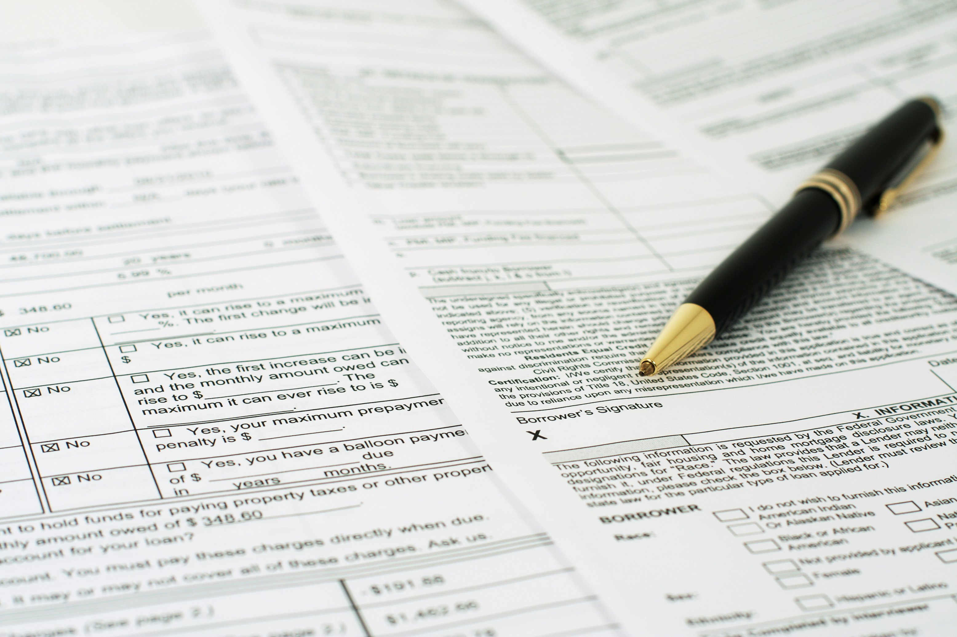





ATTENTION: FHA LOAN BORROWERS!
To download, Go to file>Export>Change File Type>Choose Either PNG OR JPG and choose the slide you want to convert to image.
Or you can click shift+F5 and screenshot for better quality
To Remove any background on your picture you can email ivan.hustleph@gmail.com or go to this website: https://www.remove.bg/
If your rate is over 6%, it is time to refinance to lower your rate to at least 0.5%.
No Tax Returns
No W2/1099
No Pay Stubs
Call me now 408-393-2068 to save you so much money on your monthly mortgage payment.
MINH CHAU NGUYEN
Loan Manager
NMLS No. 348726 - CalBRE No. 01392364
mchau@pacificwide.com
408-393-2068

Slide 2
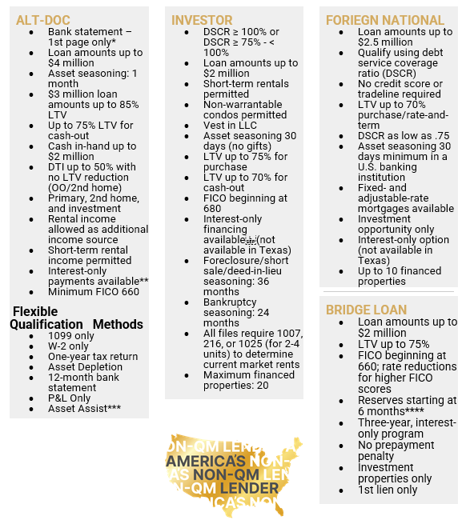

4 NON-QM LOAN PROGRAMS
To download, Go to file>Export>Change File Type>Choose Either PNG OR JPG and choose the slide you want to convert to image.
Or you can click shift+F5 and screenshot for better quality
To Remove any background on your picture you can email ivan.hustleph@gmail.com or go to this website: https://www.remove.bg/
MINH CHAU NGUYEN
Loan Manager
NMLS No. 348726 - CalBRE No. 01392364
mchau@pacificwide.com
408-393-2068

Slide 3




To download, Go to file>Export>Change File Type>Choose Either PNG OR JPG and choose the slide you want to convert to image.
Or you can click shift+F5 and screenshot for better quality
WONDERING HOW DIVORCE MIGHT AFFECT YOUR MORTGAGE?
To Remove any background on your picture you can email ivan.hustleph@gmail.com or go to this website: https://www.remove.bg/
WE UNDERSTAND THE EMOTION AND THE URGENCY THAT GO ALONG WITH DIVORCE. IF YOU NEED ASSISTANCE FIGURING OUT WHAT HAPPENS NEXT WITH YOUR MORTGAGE, WE'RE HERE FOR YOU.
You have options, and we'd like to talk your through some great financing benefits to help you move to your next chapter quickly and efficiently.
  Rate/term refinances available up to 97% LTV - including when paying off a spouse.
  3 month proof of payment for child support/alimony payments.
  Fast turn times, often less than 20 days.
  Dual closing available.
LET US HELP YOU NAVIGATE THE NEXT CHAPTER EASILY
MINH CHAU NGUYEN
Loan Manager
NMLS No. 348726 - CalBRE No. 01392364
mchau@pacificwide.com
408-393-2068

