Slide 1



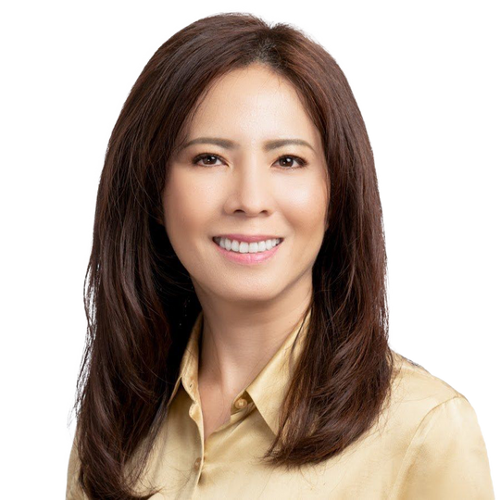




To download, Go to file>Export>Change File Type>Choose Either PNG OR JPG and choose the slide you want to convert to image.
Or you can click shift+F5 and screenshot for better quality
LOAN THAT WORKS FOR ALL SELF -EMPLOYED & BUSINESS OWNERS!
To Remove any background on your picture you can email ivan.hustleph@gmail.com or go to this website: https://www.remove.bg/
PURCHASE LOAN: OWNER OCCUPIED
REFINANCE CASH OUT: OWNER OCCUPIED
Loan Amount <$1.5Mil
80% Loan To Value with 750 Middle Credit Score
65% Loan To Value with 575 Middle Credit Score
Loan Amount <$1.5Mil
80% Loan To Value with 750 Middle Credit Score
65% Loan To Value with 575 Middle Credit Score
Loan Amount <$2Mil
75% Loan To Value with 750 Middle Credit Score
65% Loan To Value with 575 Middle Credit Score
Loan Amount <$2Mil
75% Loan To Value with 750 Middle Credit Score
65% Loan To Value with 575 Middle Credit Score
Loan Amount <$3Mil
70% Loan To Value with 750 Middle Credit Score
65% Loan To Value with 575 Middle Credit Score
Loan Amount <$3Mil
70% Loan To Value with 750 Middle Credit Score
65% Loan To Value with 575 Middle Credit Score
Loan Amount <$4Mil
65% Loan To Value with 700 Middle Credit Score
Loan Amount <$4Mil
65% Loan To Value with 700 Middle Credit Score
MINH CHAU NGUYEN
Loan Manager
NMLS No. 348726 - CalBRE No. 01392364
mchau@pacificwide.com
408-393-2068

Slide 2

ATTENTION: BUSINESS OWNERS & SELF-EMPLOYED BORROWERS!
To download, Go to file>Export>Change File Type>Choose Either PNG OR JPG and choose the slide you want to convert to image.
Or you can click shift+F5 and screenshot for better quality
PURCHASE LOAN: OWNER OCCUPIED
NO TAX RETURN, NO 1099
Loan Amount <$1,500,000.00
10% Down Payment with 700+ Middle Credit Score
To Remove any background on your picture you can email ivan.hustleph@gmail.com or go to this website: https://www.remove.bg/
15% Down Payment with 675+ Middle Credit Score
20% Down Payment with 650+ Middle Credit Score
25% Down Payment with 625+ Middle Credit Score
35% Down Payment with 575+ Middle Credit Score
Please call or DM 408-393-2068 for 2nd Home, and Rental Property
MINH CHAU NGUYEN
Loan Manager
NMLS No. 348726 - CalBRE No. 01392364
mchau@pacificwide.com
408-393-2068

Slide 3

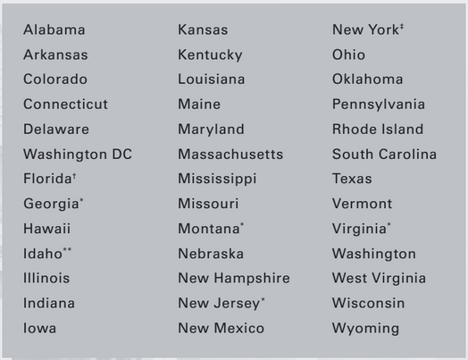
ATTENTION: BUSINESS OWNERS & SELF-EMPLOYED BORROWERS!
To download, Go to file>Export>Change File Type>Choose Either PNG OR JPG and choose the slide you want to convert to image.
Or you can click shift+F5 and screenshot for better quality
NO TAX RETURN, NO 1099
To Remove any background on your picture you can email ivan.hustleph@gmail.com or go to this website: https://www.remove.bg/
WE CAN DO LOANS IN 40 STATES INCLUDING CALIFORNIA!
Up to $4Mil Loan Amount
Refinance Cash-out
Purchase Loan
575+ Credit Score
MINH CHAU NGUYEN
Loan Manager
NMLS No. 348726 - CalBRE No. 01392364
mchau@pacificwide.com
408-393-2068

